Slide 1
Doubling-Adding Microwave Radiative Transfer Model
Ryan Honeyager

Slide 2
Overview
Most models assume that scattering sources within an atmosphere are oriented according to an isotropic distribution.
This is not the case for large particles (ice crystals)
The major axes of these crystals tend to be parallel to the ground (the crystal face normal points upwards)
The orientation distribution ranges a few degrees around a mean
This prevents many phase function decomposition techniques, and violates an assumption of the discrete ordinates method
Not an issue at small wavelengths
Effect quite visible in microwave remote sensing

Slide 3
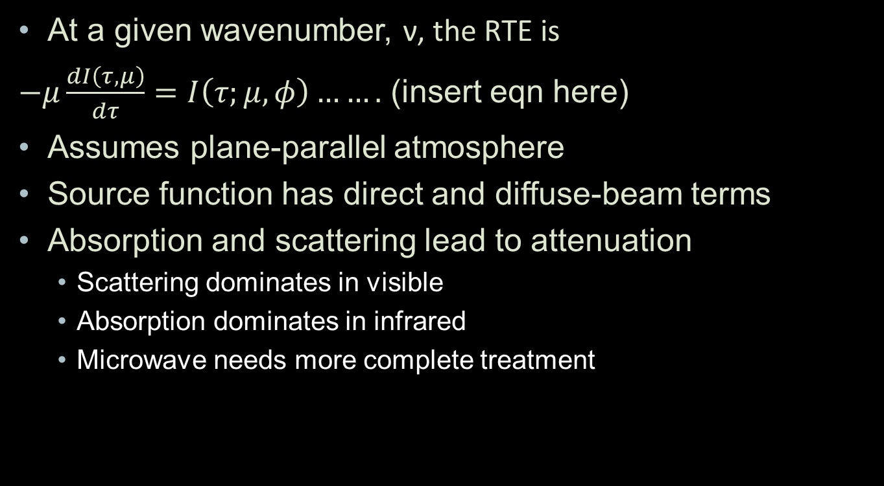
Radiative Transfer Equation
At a given wavenumber, ν, the RTE is
$−μ\frac{dI\left(τ,μ\right)}{dτ}=I\left(τ;μ,φ\right)…….$ (insert eqn here)
Assumes plane-parallel atmosphere
Source function has direct and diffuse-beam terms
Absorption and scattering lead to attenuation
Scattering dominates in visible
Absorption dominates in infrared
Microwave needs more complete treatment

Slide 4

Müeller Matrices
Rayleigh:
$$S_{11}=S_{22}=1+\cos^{2}{θ} \\ S_{12}=S_{21}=\sin^{2}{θ} \\ S_{33}=S_{44}=\cos{θ} \\ S_{ij} =0 ∀ \text{other} \text{i}\text{,}\text{j}$$
Mie:
$$S_{11}=S_{22}=…$$
Rayleigh-Gans:

Slide 5
Phase Function Relationship

Slide 6
Doubling-Adding Method

Slide 7
Doubling-Adding Method

Slide 8
Doubling-Adding Method

Slide 9
Integration by Quadrature

Slide 10
Intensity – Flux Calculation

Slide 11
Layer Generation Function

Slide 12
Layer Composition Dependence

Slide 13
LBLRTM Extension

Slide 14
Layer Generation Function

Slide 15
Atmosphere Generation

Slide 16
Atmospheric Profiles

Slide 17
Multiple Wavenumbers

Slide 18
Clouds

Slide 19
Plane-Parallel Violations

Slide 20
Cloud Top Brightness Temperature

Slide 21
rtmath To-Do List

Slide 22
Basic Case Comparison: MLS

Slide 23
Basic Case Comparison: MLW

